Slide 1
An hour with database and sql
MArIhacks learnathon
Iraj hedayati

Slide 2



Relational database
fills
Seat 1
Caleb
Entities and their relations
One-to-one relation
Many-to-Many
Many-to-one relation
fills
Seat 2
Emma
takes
Mathematics
Caleb
takes
takes
History
Emma

Slide 3
Table
Primary Key
Unique for each row
Table or sometimes called Relation
Each entity is a table
Sometimes a relation is a table (e.g. many-to-one)
Each table is a set of Rows (also called Record or Tuple
Each Row consists a set of Columns (also called Attributes)
Key: there are different key definition but we focus only on Primary Key and Foreign Key
Schema is structure and design of database (tables and relations)
Column
ID | Name | Telephone | Age
123456 | Caleb | 5142223456 | 17
456789 | Emma | 5141119876 | 16
Row

Slide 4
Design schema
For each entity add a table that reflects attributes of that entity
For each entity select (or add) a unique column as primary key
Relations:
One-to-One and Many-to-One and One-to-Many: in the source table (e.g. student) add a column that holds primary key of destination table (e.g. seat). This is called Foreign Key)
Many-to-Many: add a table for this relation. It has Foreign Keys to each entity involved in this relation (e.g. Student ID and Course ID). It is like breaking it down to two One-to-Many and Many-to-One relations.

Slide 5
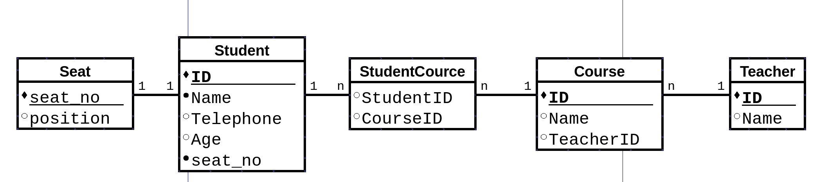

Practice

Slide 6
System requirements
An in-memory database: H2
Download: http://www.h2database.com/html/download.html
H2 is JVM based, so you need install Oracle Java 7 or later
Start using H2:
http://www.h2database.com/html/tutorial.html#tutorial_starting_h2_console
Prepare schema:
https://s3-us-west-2.amazonaws.com/prod-c2g/db/Winter2013/files/social.sql

Slide 7
SQL
A language to query a database

Slide 8
intro
Data Definition Language (DDL): define schema
Data Manipulation Language (DML):
INSERT
UPDATE
SELECT

Slide 9
INSERT
INSERT INTO table_name (column1, column2, column3, ...) VALUES (value1, value2, value3, ...);
INSERT INTO highschooler (id, name, grade) VALUES (1510, 'Jordan', 9);
INSERT INTO highschooler VALUES (1510, 'Jordan', 9);
Both are the same. Because we provided values for each column and they are in the same order.

Slide 10
update
UPDATE table_name SET column1 = value1, column2 = value2, ... WHERE condition;
UPDATE highschooler
SET name='Caleb'
WHERE id=1468

Slide 11
select
SELECT column1, column2, column3, …
FROM table1
WHERE c1 AND c2 OR c3
FROM: which table?
WHERE: filter rows
SELECT: what to return?
Column names
A function
STAR

Slide 12
SELECT
SELECT * FROM highschooler;
SELECT name FROM highschooler WHERE grade=9;
SELECT COUNT(*) FROM highschooler WHERE grade=10;
SELECT *
FROM highschooler
WHERE grade>=10 AND (name LIKE 'A%' OR id>1700)
SELECT * FROM highschooler ORDER BY name;
SELECT grade, COUNT(*) FROM highschooler GROUP BY grade;

Slide 13
Select (join)
Join operation is a cartesian product (also called FULL OUTER JOIN)
INNER JOIN only return those that match
SELECT *
FROM highschooler AS t1 JOIN likes AS t2
SELECT *
FROM highschooler AS t1 INNER JOIN likes AS t2
ON t1.ID=t2.ID1

Slide 14
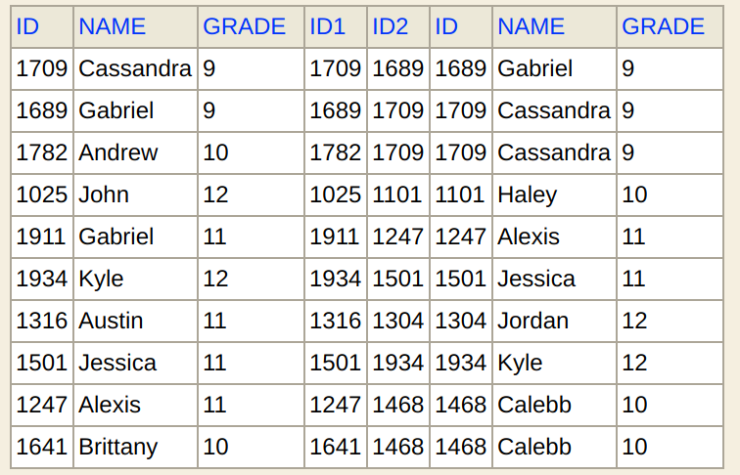
JOIN practice
Who like who?
SELECT *
FROM (
SELECT *
FROM highschooler AS t1
INNER JOIN
likes AS t2
ON t1.ID=t2.ID1
) AS t3
INNER JOIN
highschooler AS t4
ON t4.ID=t3.ID2

Slide 15


Slide 16
practice
Find the names of all students who are friends with someone named Gabriel
For every student who likes someone 2 or more grades younger than themselves, return that student's name and grade, and the name and grade of the student they like.
For every pair of students who both like each other, return the name and grade of both students. Include each pair only once, with the two names in alphabetical order.
Find all students who do not appear in the Likes table (as a student who likes or is liked) and return their names and grades. Sort by grade, then by name within each grade.

Slide 17
More resources
Stanford University online learning SQL
https://lagunita.stanford.edu/courses/DB/SQL/SelfPaced/courseware/ch-sql/seq-vid-introduction_to_sql/
H2 Tutorial:
http://www.h2database.com/html/tutorial.html
W3School SQL commands + practice:
https://www.w3schools.com/sql/
Practice SQL
https://sqlzoo.net/

